Slide 1
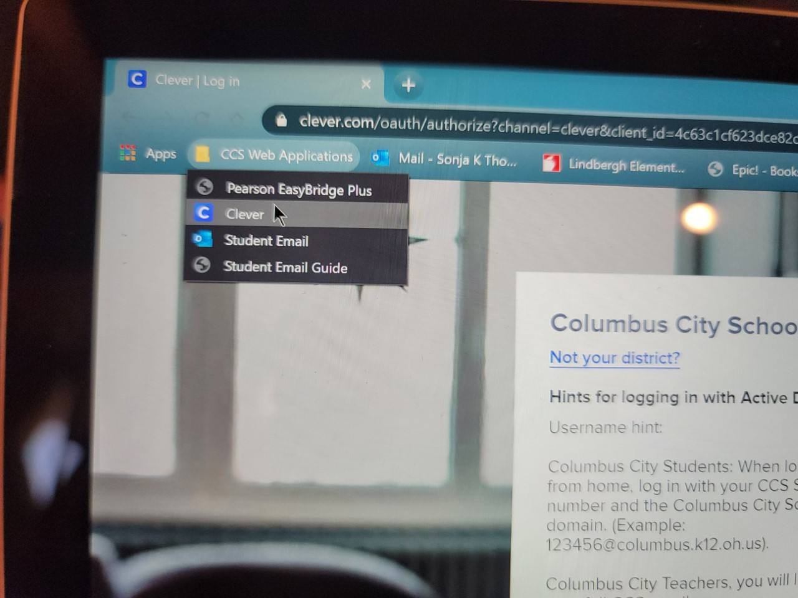
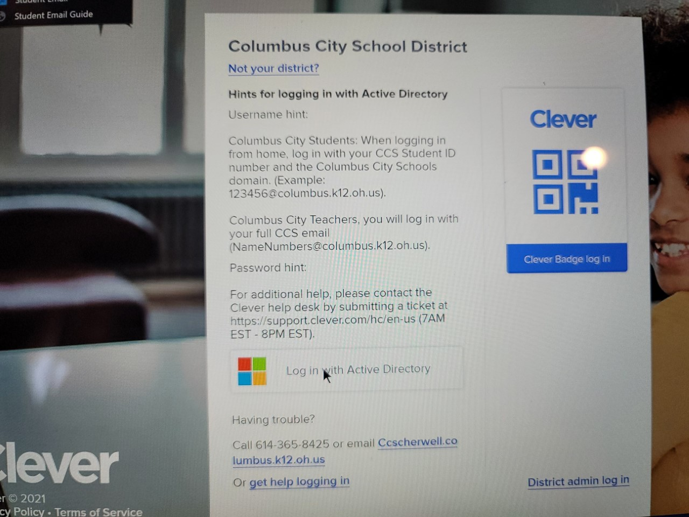
Attendance for Students:
Log in to the Clever Portal with your student ID and Password
For Parents using their personal device (control plus click to follow the link): Infinite Campus Parent Portal

Slide 2
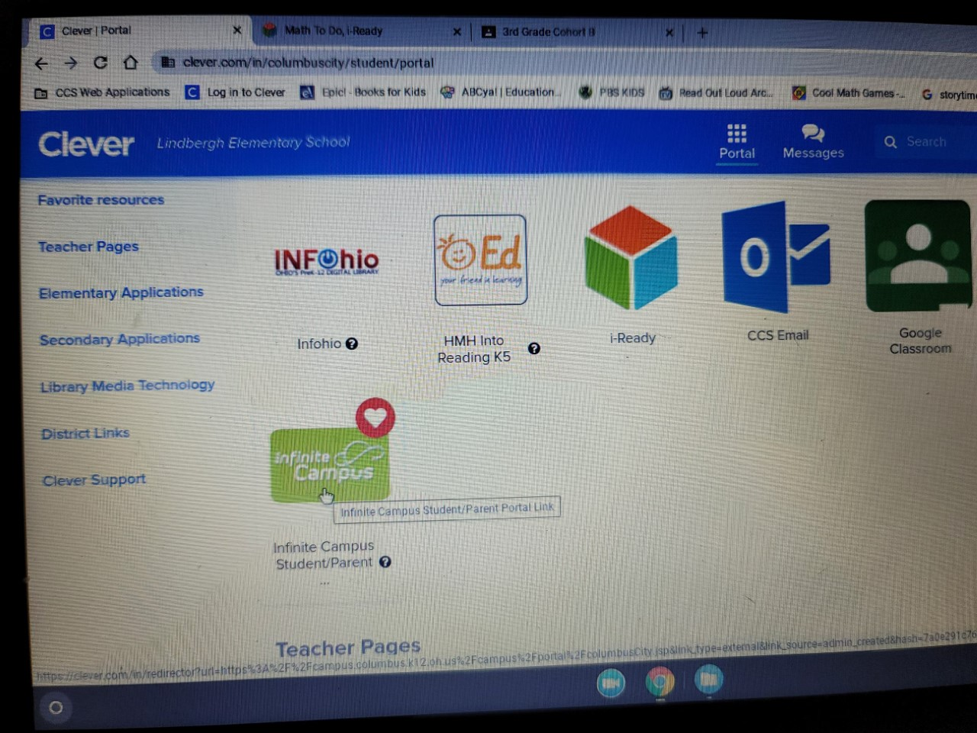
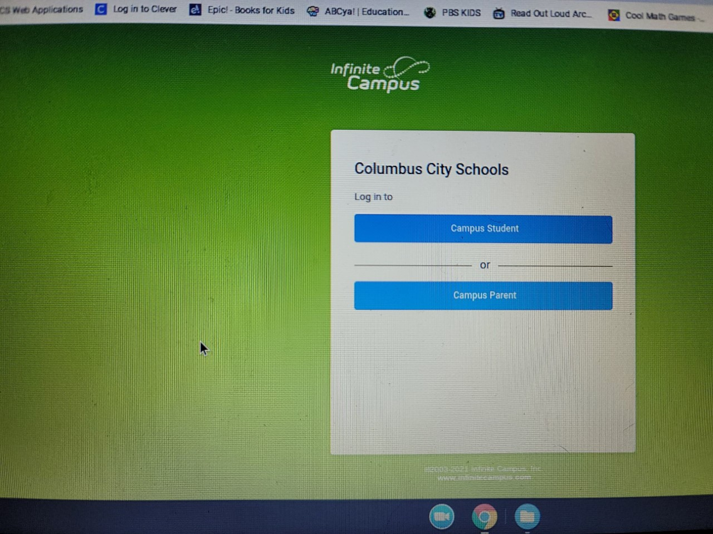
Click the Green Infinite Campus Box
Select Campus Student (if logging in as student)
Select Campus Parent if you have access and are logging in as a parent.

Slide 3
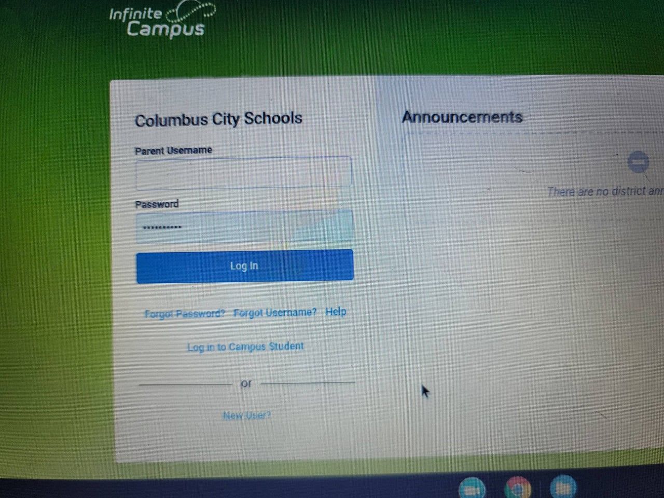
If you selected Campus student:
Enter your student ID number and password (this is the same ID and password you use to log in to your chromebook)
If you selected Campus Parent:
Enter your Parent log in information. The email entered must be the same one that you used when you registered for the Parent Portal. If you have forgotten your password- select forgot password. You will be emailed a link to reset the password if you have entered the correct user ID (be sure to check your Junk/Spam folder)

Slide 4
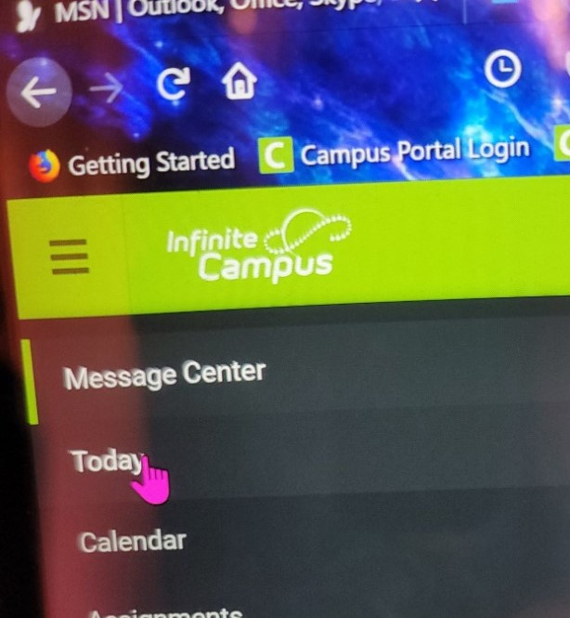
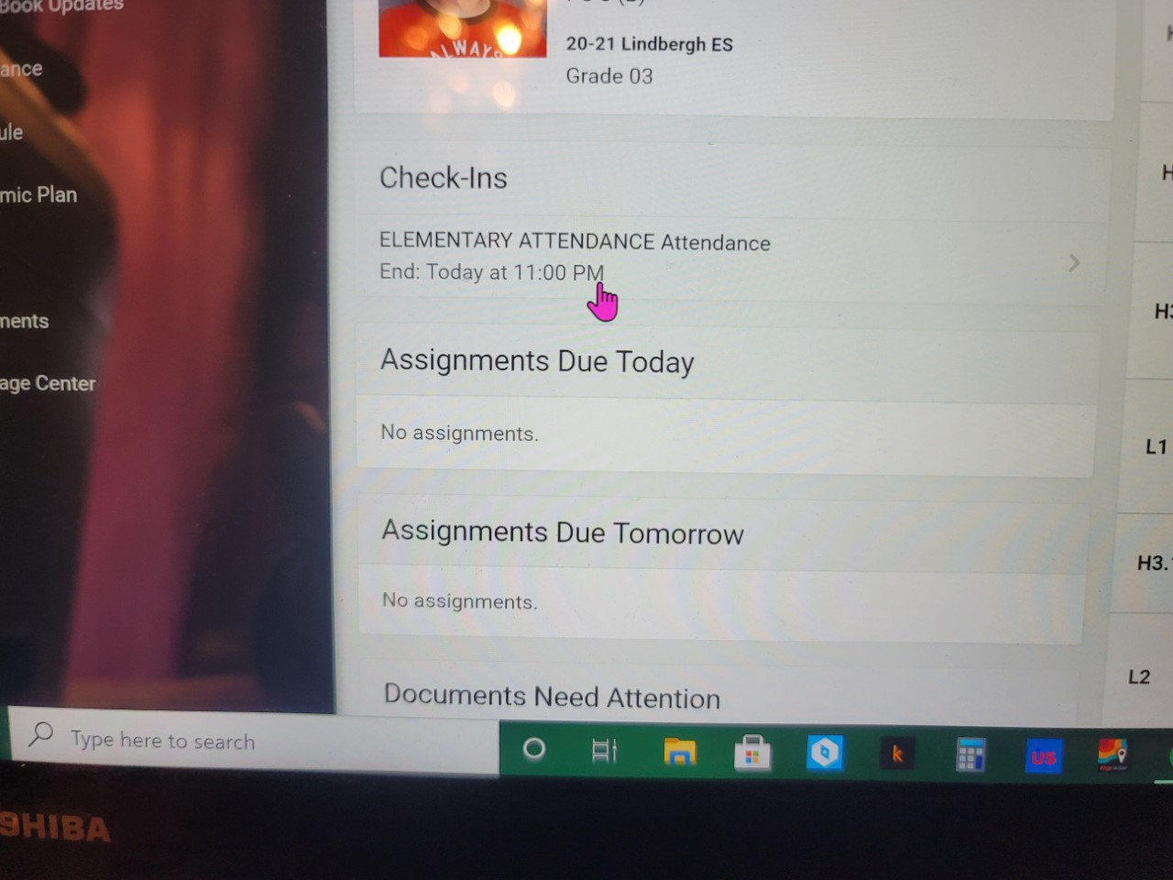
On the Left side menu, click Today
If attendance has not already been marked- you will see the Check-Ins box under the student’s picture.
Click Elementary Attendance ( a new screen will open)
If attendance has been marked already- you will not see an Elementary Attendance option.

Slide 5
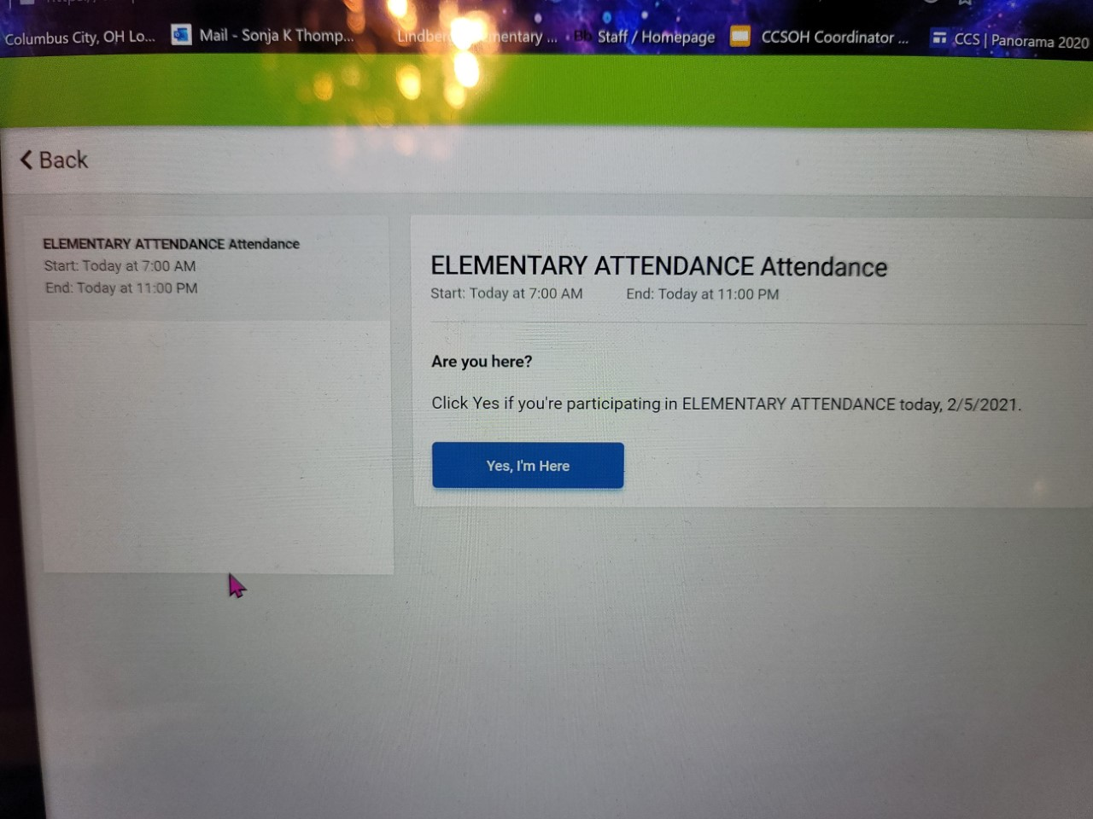
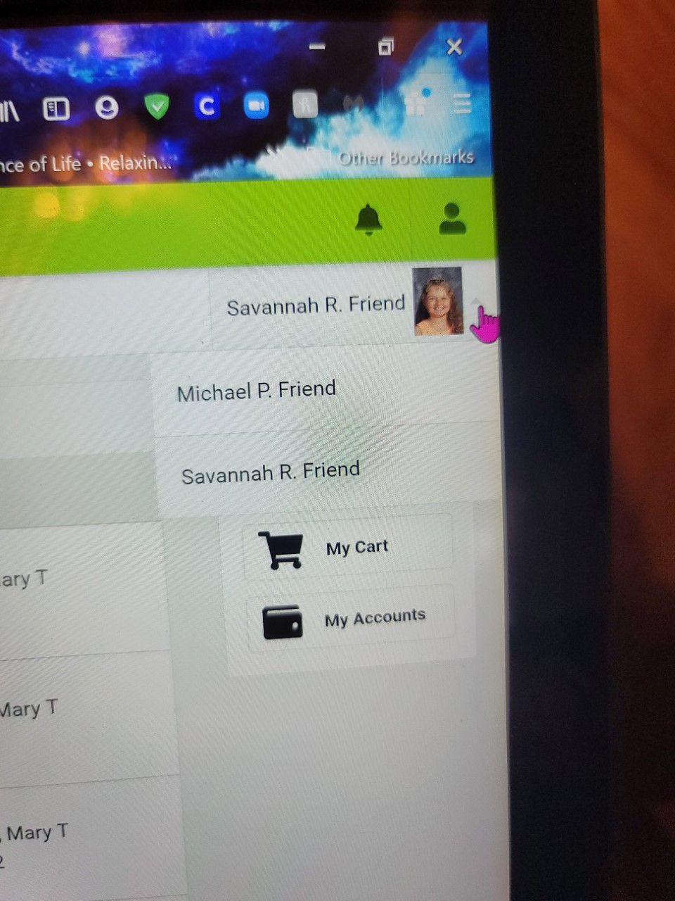
Click the Blue Yes, I’m Here button (if you are logged in as parent- the blue box will have your child’s name)
If you have more than 1 child- use the dropdown box in the upper right corner to select the other children and repeat the step above.

Slide 6
Parents: There is an app for both Iphone & Android phones. It is called Campus Parent
The first time you use it, you will need to select the school district.
Then enter your parent login information. You can select to stay logged in so you do not have to enter your login every time (If you do this be sure to write down or save your log in information somewhere so you do not forget/lose your log in information)

